Slide 1

Internal
CHAT
GPT
CITY OF IRVINE | TEAM - 12
Anish Posim Reddy | Abhishek Motlani | Aarushi Juneja | Anshuman Sharma

Slide 2
01
Ineffecient Information Retrieval
Existing search platforms lack semantic understanding, leading to suboptimal results, and prolonged search times for City staff
Problem
02
Inconsistency in Analysis
STATEMENT
Human analysis of files introduces inconsistencies and errors. A standardized, automated system is required to ensure accuracy and reliability in information extraction
“Our organization struggles with the inefficiency of file management due to a large and diverse dataset. Manual processes are time-consuming and error-prone. We require an Internal ChatGPT solution to enhance data interaction, retrieve information swiftly, and improve overall productivity." - CITY OF IRVINE
03
Time Intensive
Manual file review hampers efficiency, consuming valuable time and delaying decision-making processes for employees."
Anish Posim Reddy | Abhishek Motlani | Aarushi Juneja | Anshuman Sharma
1

Slide 3
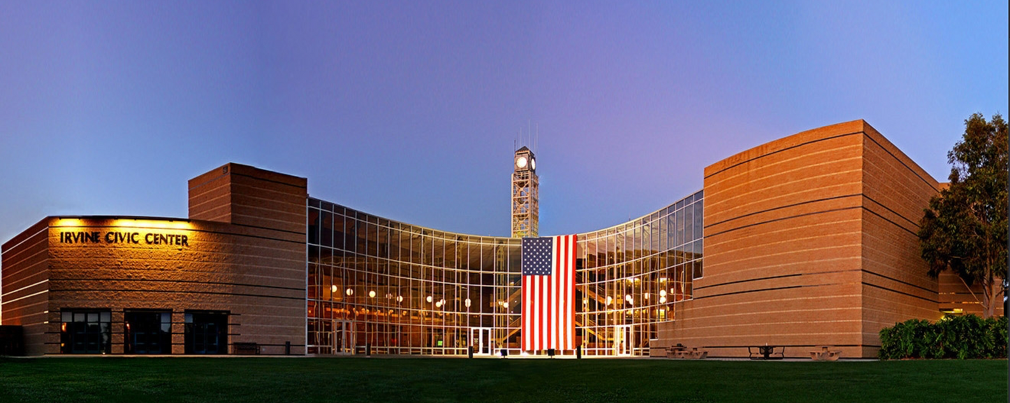
CITY OF IRVINE
DID YOU KNOW?
1
HOLLYWOOD’S BACKYARD
HOLLYWOOD'S BACKYARD: FILMS LIKE "POLTERGEIST" AND "SILICON VALLEY" SHOT HERE.
2
FROM BEANS TO BUILDINGS
ORIGINALLY, A VAST LIMA BEAN FARM
3
SAFE HAVEN
ONCE TITLED "AMERICA'S SAFEST BIG CITY”
Irvine's Digital Horizon: Bridging Citizens with AI.
4
BIKE-FRIENDLY
"Irvine 2.0: Powered by ChatGPT Conversations.”
OVER 360 MILES OF COMBINED CYCLING LANES AND TRAILS.
Anish Posim Reddy | Abhishek Motlani | Aarushi Juneja | Anshuman Sharma
2

Slide 4
FUNCTIONALITY DESIRED
Secured Infrastructure
Ensuring the safety of contracts is imperative.
Implementation of an internal chatbot powered by a generative AI model (e.g., GPT)
Advanced semantic search technology for efficient information retrieval.
1800+ Employees
Integration with diverse knowledge bases, specifically documents in the OnBase Content Services platform
Serving 1800+ employees, the functionality streamlines information retrieval for enhanced productivity.
Anish Posim Reddy | Abhishek Motlani | Aarushi Juneja | Anshuman Sharma
3

Slide 5
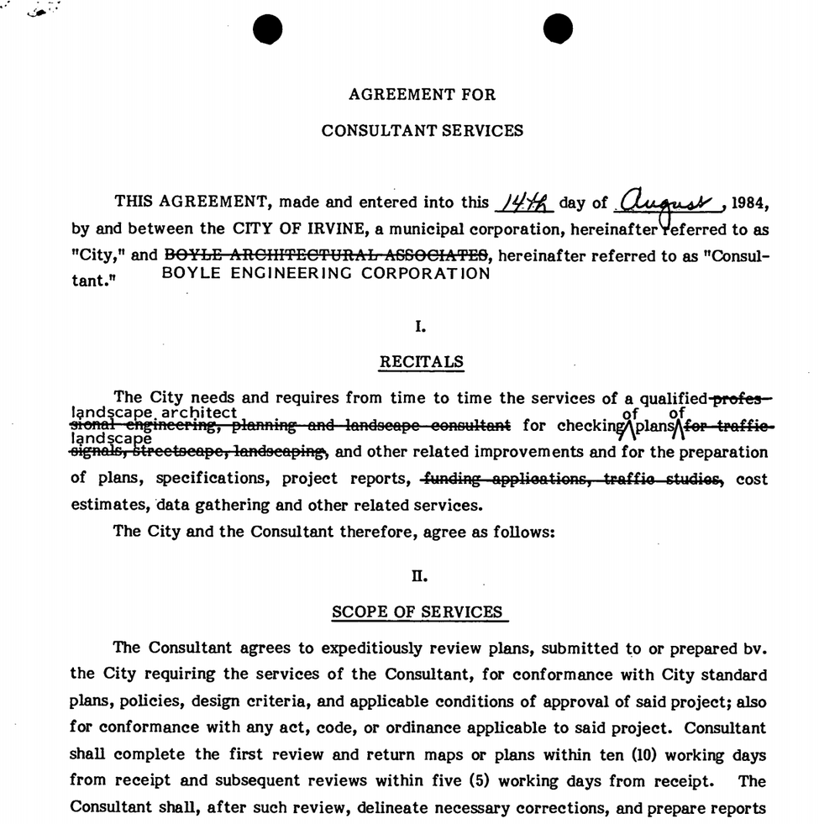

DATA
1
Disparate data = Inconsistent info retrieval.
2
Ever tried searching with just keywords? Not so fun, right?
3
Search inaccuracies? Say no more.
4
Layers of Legalese: Contracts aren't just words; they're dense
5
Ambiguous Language: Phrases like "reasonable efforts" or "as soon as possible" are open to interpretation.
Anish Posim Reddy | Abhishek Motlani | Aarushi Juneja | Anshuman Sharma
4

Slide 6



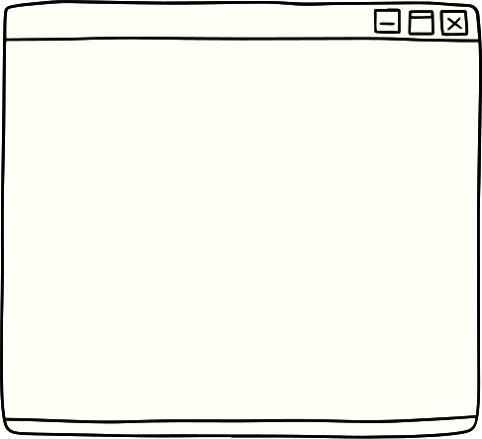



CHALLENGES
Data Preparation
Data Storing
Model Selection
Traditional storage systems face challenges in efficiently searching extensive text chunks within large datasets..
Efficiently manage LLM models with innovative solutions like LlamaIndex for optimal handling of extensive textual data.
Acquiring Data
Preprocessing the data
Selecting the optimal Llama model among multiple options poses a significant challenge in ensuring effective chatbot performance.
GPT-3.5 Turbo
GPT-4
Llama 2
Anish Posim Reddy | Abhishek Motlani | Aarushi Juneja | Anshuman Sharma
5

Slide 7
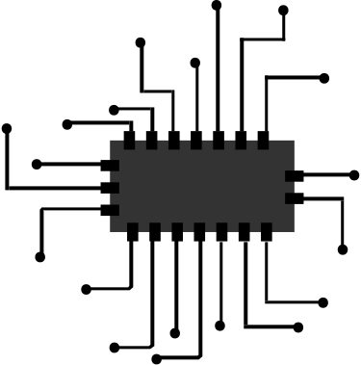



ACQUIRING DATA
ONBASE DATABASE
LLAMA INDEX
AZURE BLOB STORAGE
Anish Posim Reddy | Abhishek Motlani | Aarushi Juneja | Anshuman Sharma
6

Slide 8




Data Ingestion
Connect your existing data sources and data formats (API's, PDF's, documents, SQL, etc.) to use with a large language model application
LLAMA INDEX
Data Indexing
Store and index your data for different use cases. Integrate with downstream vector store and database providers.
LlamaIndex is a simple, flexible data framework for connecting
custom data sources to large language models.
Query Interface
LlamaIndex provides a query interface that accepts any input prompt over your data and returns a knowledge-augmented response.
Anish Posim Reddy | Abhishek Motlani | Aarushi Juneja | Anshuman Sharma
7

Slide 9


Cost
Llama 2 is significantly cheaper to use than GPT-3.5 turbo and GPT-4.
Accuracy
Llama 2 boasts a comparable level of accuracy to GPT-4., but beats GPT 3.5 turbo
Comparison
3 AI Models to compare:
LLama2
GPT-3.5 Turbo
GPT-4
Efficiency
Llama 2 is much faster and more efficient than GPT-3.5 turbo and GPT-4, making it a good choice for tasks that require real-time performance.
Transparency
Llama 2 is an open-source model, which means that its code is available for anyone to inspect and modify.
Anish Posim Reddy | Abhishek Motlani | Aarushi Juneja | Anshuman Sharma
8

Slide 10
01
Utilizing Hugging Face Embedding
MODEL OVERVIEW
02
Chroma Db for Storing Data in Vector Format
03
Retrieving Stored Data for LLM Implementation
Anish Posim Reddy | Abhishek Motlani | Arushi Juneja | Anshuman Sharma
9

Slide 11
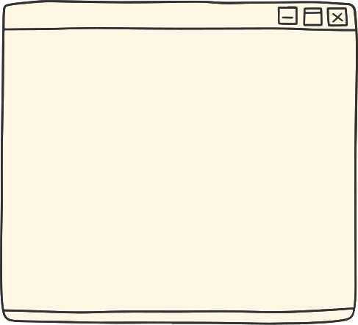
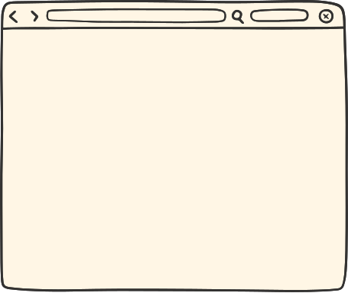







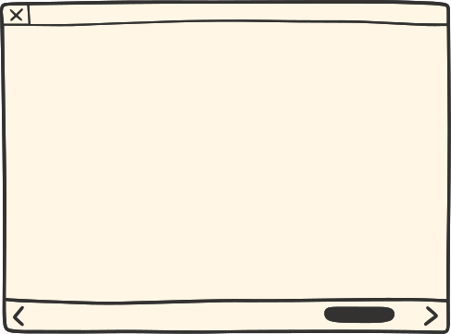
Architecture
Question
Semantic
Search
Generated
Response
Chunk 1
Embedding 1
Documents
Splitting
Chunk 2
Embedding 2
Build Semantic
Index
LLM
Chunk 3
Embedding 3
Context
Acts as a knowledge
base
Re-Ranked
results
Anish Posim Reddy | Abhishek Motlani | Arushi Juneja | Anshuman Sharma
10

Slide 12




ADVANTAGES OF THIS ARCHITECTURE
Efficient Workflow
Secured
Storing the indexed format to avoid delays
Using a quantized model of LLama 2.
Semantic search
Using LLama 2 on local to avoid any security issues.
Did all the preprocessing of data locally to avoid sharing sensitive data.
The model is runing on a Local Machine
Accuracy
Scalable
Using the 13B model got great results. High accuracy in less time.
Indexing according to use case
Established a modular pipeline that exhibits scalability based on usage, capable of accommodating diverse datasets.
Anish Posim Reddy | Abhishek Motlani | Aarushi Juneja | Anshuman Sharma
11

Slide 13
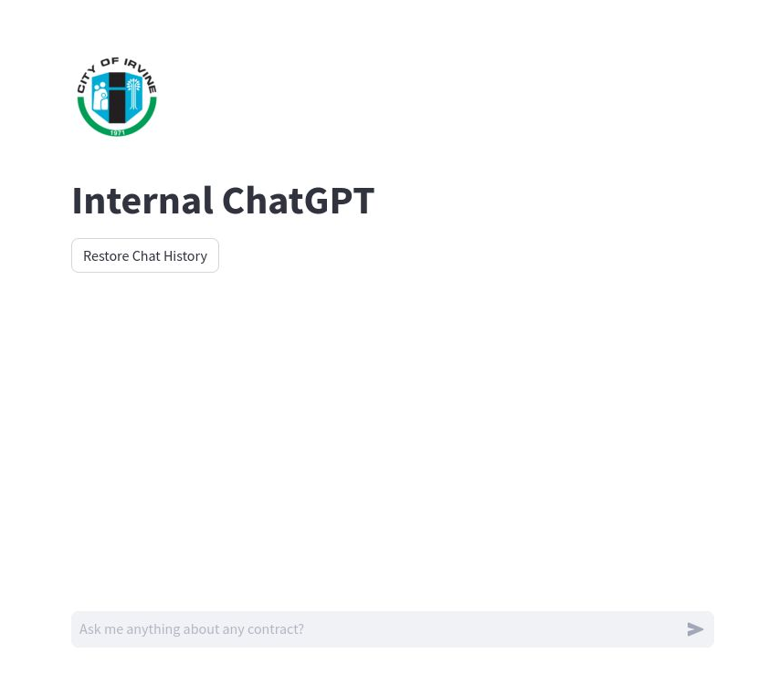
INTERNAL CHATGPT
Current Functionalities
1)We currently possess a chat engine designed for single user.
2)Presently utilizing a vector index system.
Future Prospects
1) Create a personalized chat engine tailored for multiple individual users.
2)Develop a more sophisticated indexing like tree index, key-word table index
Anish Posim Reddy | Abhishek Motlani | Aarushi Juneja | Anshuman Sharma
12

Slide 14
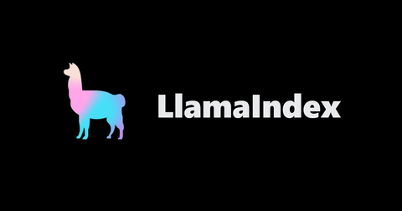
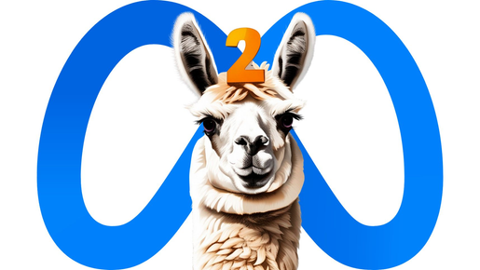



INFERENCE FLOW
Load Llama2 - 13b chat using LlamaCPP. Specify temperarure, max_new_tokens, context_widow, n_gpu_layers
Load bge-small-en-v1.5 embedding model from Huggingface
Load Persisted Vector Store indexed contracts using LlamaIndex
Initialize chat engine with context chat mode and memory buffer
Get response to User Queries by fetching most relevant nodes
Cache Resource Using Streamlit
Anish Posim Reddy | Abhishek Motlani | Aarushi Juneja | Anshuman Sharma
13

Slide 15

EVALUATION PIPELINE
Generate Questions using Llama2 and Llamaindex on a small subset of nodes
Initialize Evaluators as needed (Faithfulness, Relevancy, etc.)
Perform Batch Evaluation with multiple workers
Report Total Scores for each metric
Faithfulness | Relevancy
85% | 80%
Anish Posim Reddy | Abhishek Motlani | Aarushi Juneja | Anshuman Sharma
14

Slide 16

ESTIMATING FAITHFULNESS
Response Text -
Based on the provided context information, the purpose of establishing reciprocal easements for access, ingress, and egress to and from the lots is to grant each owner the right to...
Evaluation Module - Matches?
Query:
What is the purpose of establishing reciprocal easements for access, ingress, and egress to and from the lots?
Index Data Structure - fetches all records with reciprocal easements
Response Object
Response Source -
OWNER TWO grants to OWNER ONE an easement (hereinafter "Second Easement") of ingress and egress upon Property Two as may reasonably be necessary for the conducting, or causing
...
Anish Posim Reddy | Abhishek Motlani | Aarushi Juneja | Anshuman Sharma
15

Slide 17
ESTIMATING RELEVANCY
Response Text -
Based on the provided context information, the two easements granted by Vanderbilt..
Query:
What are the two easements granted by Vanderbilt Investment Company to the City of Irvine?
Index Data Structure - fetches all records with Vanderbilt Investment Company
Response Object
Evaluation Module - Matches?
Response Source-
Vanderbilt is about to construct industrial buildings sharing a common wall erected on the property line dividing Lot 49 from Lot 56. The Building Department of Irvine has requested, ...
Anish Posim Reddy | Abhishek Motlani | Aarushi Juneja | Anshuman Sharma
16

Slide 18
AREAS TO EXPLORE
Support more Data Formats
Advanced Indexes
Composable Graph
Response Mode
Get more refined responses with different modes from response synthesizer
Parse more data formats like JPEG, TIFF efficiently
Explore indexes like Tree, Keyword table, knowledge graph
Consider composing multiple indexes with a parent index
Retriever Mode
Better LLM Model
More Evaluation Metrics
Asynchronous Support
Explore advanced retrieval methods like auto-retrieval, routing, ensembling, and more
Chose a better base LLM model with more parameters
Perform Eval on more quantitative and qualitative metrics
Seamlessly support multiple chat sessions
Anish Posim Reddy | Abhishek Motlani | Aarushi Juneja | Anshuman Sharma
17

Slide 19
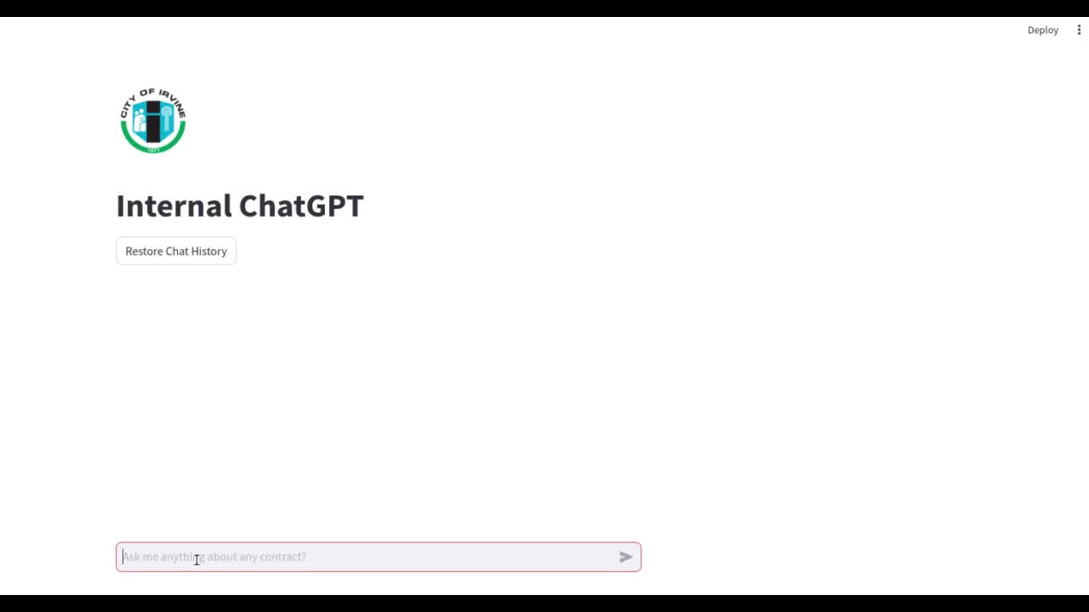
Model In Action
Anish Posim Reddy | Abhishek Motlani | Aarushi Juneja | Anshuman Sharma
18

Slide 20
THANK YOU
CITY OF IRVINE - TEAM 12
Anish Posim Reddy
Abhishek Motlani
Aarushi Juneja
Anshuman Sharma

